Slide 1




CSS Boiler Plates
Skeleton, Twitter Bootstrap
Telerik Software Academy
Learning & Development Team
http://academy.telerik.com

Slide 2

Table of Contents
Skeleton Grid
Twitter Bootstrap 3.0
Grid System
Default CSS styles
Form
Buttons
Tables

Slide 3
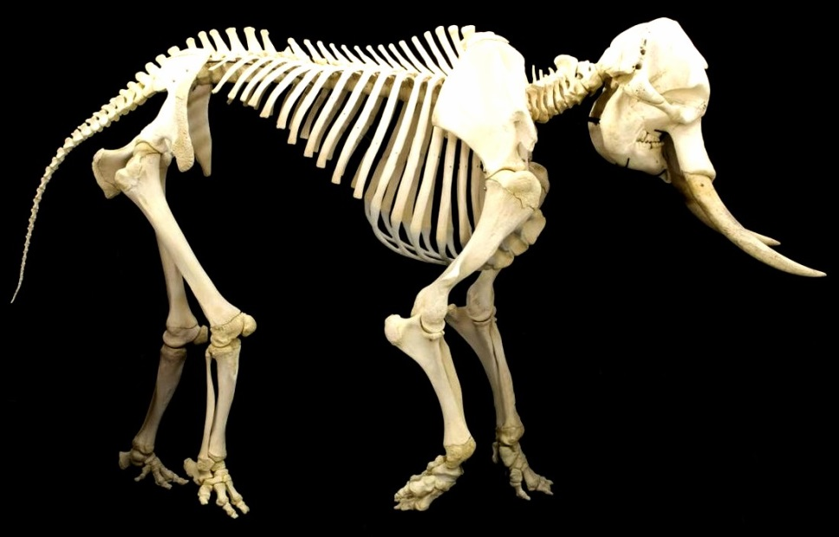
Skeleton

Slide 4
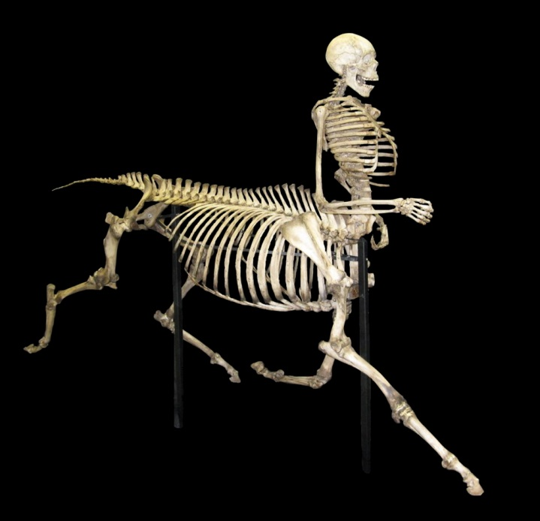
Skeleton
Skeleton
Download at: http://www.getskeleton.com/
Responsive down to mobile
Fast to start
Lightweight
Base for styling
Easy to use grid system

Slide 5

Skeleton Installation
Skeleton Installation
Download from http://www.getskeleton.com/
Add base.css to your HTML
Add skeleton.css to your HTML
Add layout.css to your HTML
Done!

Slide 6
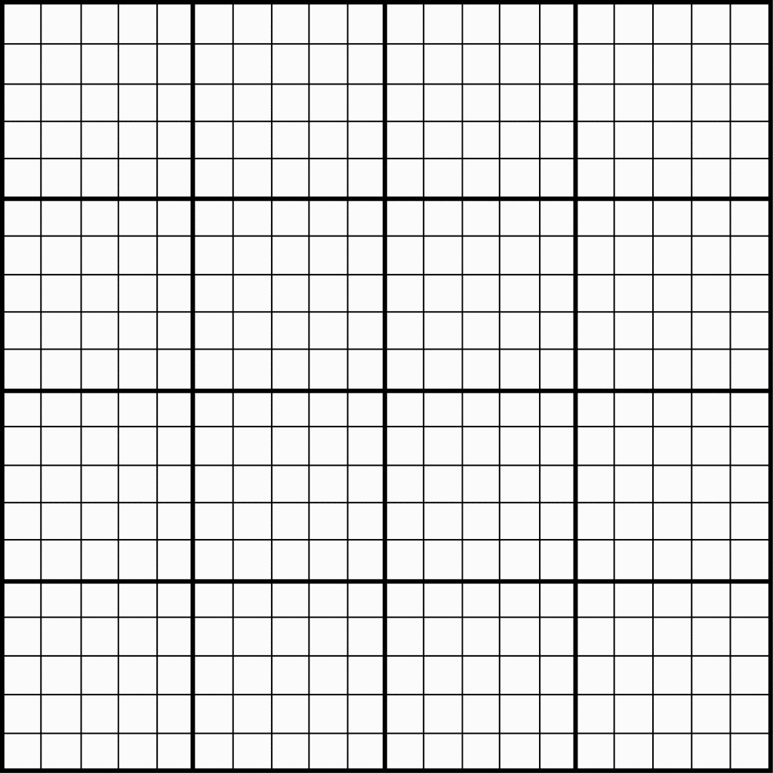
Skeleton Grid
Skeleton Grid
16 column-based grid
.container class for wrapper
.row class for displaying row
.one, .two, … .columns classes for columns
supports nesting of columns
Great tutorial here:
http://designshack.net/articles/css/build-a-responsive-mobile-friendly-web-page-with-skeleton/

Slide 7
Skeleton Examples
Example
<div class="container">
<div class="row">
<div class="one column">
<div class="border">1/3</div>
</div>
<div class="two columns">
<div class="border">2/3</div>
</div>
</div>
</div>

Slide 8
Skeleton Grid
Live Demo

Slide 9

Twitter Bootstrap

Slide 10

Bootstrap 3.0
Twitter Bootstrap
Download at: http://getbootstrap.com/
Responsive down to mobile
Complete CSS framework
Feature-rich
A lot of themes (free and paid)
Easy to use
There is also a famous 2.3.2 version

Slide 11

Bootstrap 3.0
Twitter Bootstrap Installation
Download at: http://getbootstrap.com/
Add bootstrap.min.css to your HTML
Add jQuery to your HTML
Add bootstrap.min.js below jQuery
Done!

Slide 12
Bootstrap 3.0
Grid system
12 column-based grid system
.container class for grid wrapper
.row class for rows
.col-md-# for columns
Examples
http://getbootstrap.com/examples/grid/

Slide 13
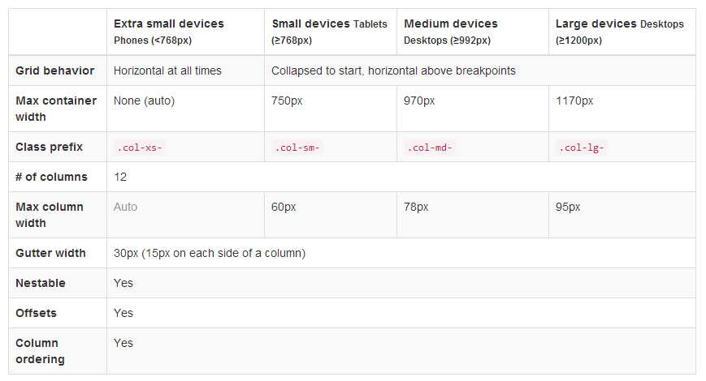
Bootstrap 3.0
Grid system options

Slide 14
Bootstrap Grid Example
Example
<div class="container">
<div class="row">
<div class="col-md-4">
<div class="border">1/3</div>
</div>
<div class="col-md-8">
<div class="border">2/3</div>
</div>
</div>
</div>

Slide 15
Bootstrap Grid
Live Demo

Slide 16

Bootstrap 3.0
Default Typography
Headings
Paragraphs (can add class .lead)
<small>, <em>, <strong>
Built-in alignment classes
.text-left
.text-center
.text-right

Slide 17
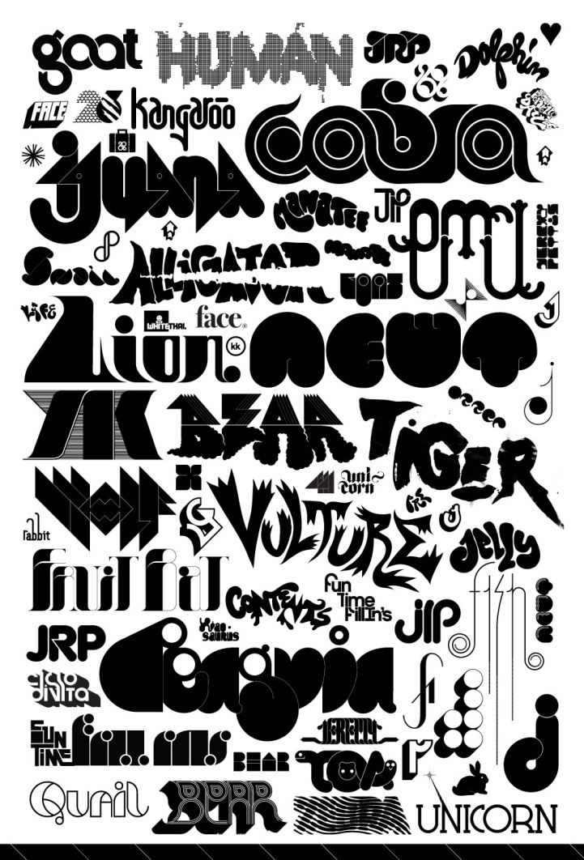
Bootstrap 3.0
Default Typography – text colors
.text-muted – grey
.text-primary – light blue
.text-success – green
.text-info – dark blue
.text-warning – yellow
.text-danger – red

Slide 18
Bootstrap Typography
Live Demo

Slide 19
Bootstrap 3.0
Tables - on <table> elements
.table – default table
.table-striped – every second row is colored
.table-bordered – adds border to a table
.table-hover – adds hover element to a table
.table-condensed – makes the table compact
Tables – on <tr> and <td> elements
.active, .success, .warning, .danger

Slide 20
Bootstrap Tables
Live Demo

Slide 21

Bootstrap 3.0
Forms
Add .form to the <form> element
Add .form-control to all form elements
Group them with .form-group
Buttons
.btn for buttons
.btn-primary, .btn-danger, … for colors
.btn-lg, btn-sm, btn-xs for sizes

Slide 22
Bootstrap Forms and Buttons
Live Demo

Slide 23

Bootstrap 3.0
Images
.img-rounded – for image with round edges
.img-circle – for image as circle
.img-thumbnail – adds small border
Helper classes
Close icon - .close on any button
Quick float - .pull-left, .pull-right

Slide 24
Bootstrap Images
Live Demo

Slide 25
Bootstrap Other
Live Demo

Slide 26
Semantic Web
http://academy.telerik.com

Slide 27
Homework
Create web site by your choice with a free theme for Bootstrap. It should:
Have at least 3 pages
Use at least 10 components
Looks complete

